Slide 1
Urban Tree Presence and Multifamily Residential Building Energy Use in New York City
John Ferrara

Slide 2
Agenda
Introduction & Motivation
Research Question & Study Design
Data Sources & Processing
Working Dataset
Modeling & Analysis
Conclusions & Future Work

Slide 3
Introduction

Slide 4
Introduction: The Motivation
Urban trees provide widely documented environmental benefits
(cooling, air quality, stormwater mitigation)
Cities increasingly rely on trees as part of climate resilience strategies.
Buildings are the largest source of carbon emissions in New York City.
Reducing building energy use is a key policy priority, so understanding factors that influence building energy use is a major policy concern.
A natural question emerges:
  Can urban trees measurably reduce building energy consumption?

Slide 5
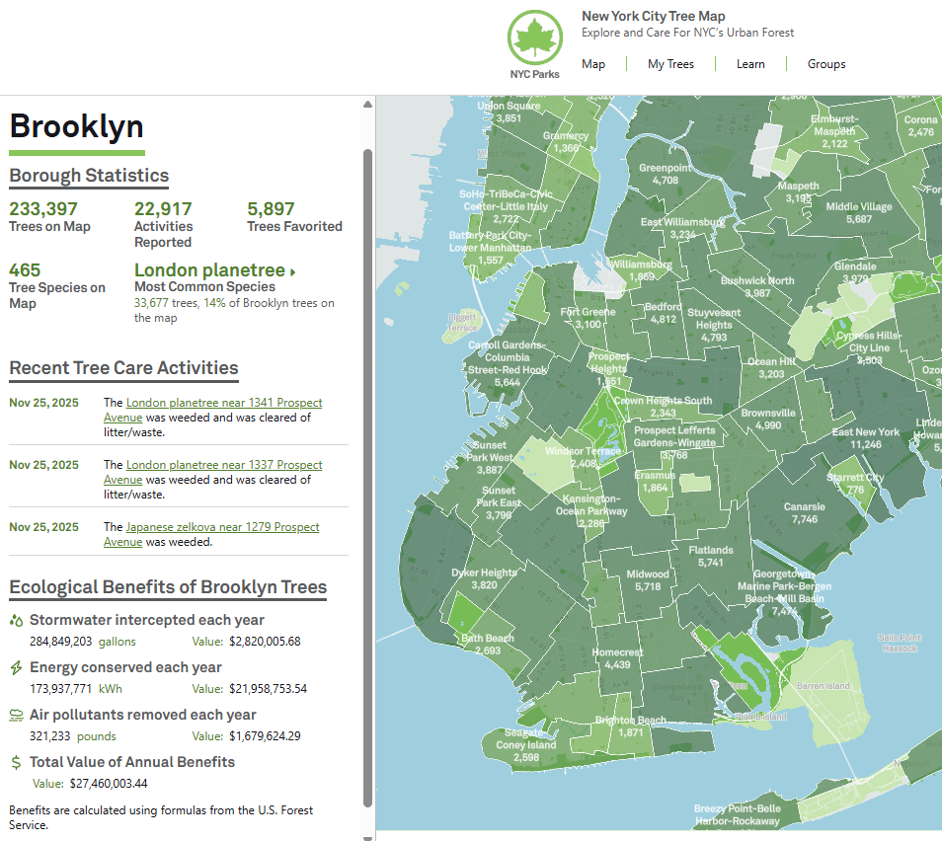
Introduction: Existing Tools & Assumptions
  NYC Tree Map estimates substantial ecological and energy benefits from trees,
  These estimates rely on USDA Forest Service i-Tree models.
  i-Tree is widely used, but based on generalized equations
  Empirical validation using observed building energy data is limited.
  Especially in dense, multifamily urban environments

Slide 6
Introduction: Other Research
McPherson & Rowntree (1993): Energy Conservation Potential of Urban Tree Planting
  Examined one and two-story single-family homes
  Found cooling energy savings of approximately 10-15%; Peak demand reductions of 8-10%.
McPherson & Simpson (1999): Carbon Dioxide Reduction Through Urban Forestry
  Studied tree impacts on heating and cooling via shading and wind reduction for primarily low-rise, single-family structures.
  Found 25-43% reductions in cooling demand in the presence of mature trees.
  Results varied by building construction era.
He et al. (2021): Cooling Effect of Urban Trees and Its Spatiotemporal Characteristics
  Analyzed tree cover and land surface temperature in Boston and D.C.
  Found non-linear cooling effects, strongest during extreme heat events.
  Demonstrated that tree benefits increase with higher temperatures.
Zhu et al. (2022): Impact of Urban Vegetation Morphology on Building Energy Consumption
  Studied low-rise structures in Nanjiing, China.
  Found vegetation reduces both cooling and heating needs, by depends on building proximity and type of vegetation.
Ravazdezh & Rivers (2025): Quasi-experimental Evidence that the Urban Tree Canopy Reduces Residential Energy Consumption
  Used difference-in-differences on ~2,000 single-family homes in Ottawa, Canada.
  Found a 2.9% reduction in electricity use from a 10% canopy increase.

Slide 7
Research Question
Naturally, the question asked for this project was:
Do changes in surrounding tree presence produce measurable changes in weather normalized energy use intensity for multifamily residential buildings in New York City between 2010 and 2017?
Based on other studies, my hypothesis was:
Greater tree presence, measured via canopy coverage and tree counts, is expected produce measurable changes in weather normalized EUI.

Slide 8
Study Design
The study compares changes in building energy use over time across buildings exposed to different canopy change conditions to test whether changes in nearby tree presence are associated with changes in energy use.
This requires:
  Observing building energy use at two points in time.
  Identifying where tree presence increased, decreased, or stayed the same
The key variables in this study:
  Weather normalized Energy Usage Intensity (EUI).
    How much energy building would use under normal weather conditions (Total Annual Energy Consumption ÷ Total Floor Area).
  Tree Count within 50-foot proximity to buildings
  Canopy Coverage Changes within 50-feet of buildings.
  Other building characteristics (Number of Stories, Year built, etc.)

Slide 9
Data Sources & Processing

Slide 10
Data Sources: Custom Dataset Needed
No single dataset links trees to buildings in NYC
A custom longitudinal dataset was built.
Multiple data sources, mainly from NYC Open Data.
Three Part Pipeline Used

Slide 11
Data Sources: Core Sources
New York City Local Law 84 Energy Benchmarking data
LiDAR-based tree canopy coverage change (2010 through 2017) data
NYC Forestry tree point inventory data
NYC Forestry Work Order data
NYC Primary Land Use Tax Lot Output (PLUTO) data
NYC Building Footprint Outline data
Supplemental geocoding and census geography data

Slide 12
Data Processing: Part 1 (Buildings & Energy)
Ingested NYC Local Law 84 energy benchmarking data via API
Initially processed all available years (2010 through 2024), then limited to 2010 and 2017
Filtered dataset to residential properties only. Retained only those instances where energy metering measured the whole property.
Standardized column names and formats across years.
Enriched missing Borough Block Lot (BBL) identifiers using self-joins and NYC Planning Labs API.
Enriched data where Latitude and Longitude were missing with Google Maps API
Joined PLUTO data in via BBL for building characteristics (Year Built, Number of floors, Residential Units, Building height).
Added NYC building footprint geometries via BBL to enable spatial analysis.
Spatially joined LiDAR-based canopy changes for each building using a 50-foot buffer.

Slide 13
Data Processing: Part 1 (Buildings & Energy)
Original Column Name | Example Value | Column Description
year_ending_year | 2010 | Calendar/fiscal year of data
property_id | 2552023 | Internal property identifier
bbl | 1022020009 | Borough–Block–Lot ID
address_1 | 420 West 206th Street | Primary street address
city | New York | City name
gfa_building_ft2 | 77967 | Gross floor area of building (ft²)
site_eui_kbtu_ft | 101.2 | Site EUI (kBtu/ft²)
weather_normalized_site_eui | 99.5 | Weather normalized site EUI.
site_energy_use_kbtu | 7,892,541.1 | Total site energy use (kBtu)
source_energy_use_kbtu | 11,458,759.9 | Total source energy use (kBtu)
postcode | 10034 | ZIP code
Borough | Manhattan | NYC borough
BldgClass | D4 | Building class code
LandUse | 3 | Land use code
NumFloors | 6 | Number of floors
UnitsRes | 74 | Number of residential units
canopy_change_class | No Change | Tree canopy change classification

Slide 14
Data Processing: Part 2 (Trees)
Ingested NYC forestry tree point inventory and forestry work order datasets.
Used tree point data as baseline inventory of individual trees.
Filtered trees to those existing between 2010 and 2017.
Removed dead trees and stumps using condition and structure fields.
Used work orders to identify and timestamp tree removals.
Assumed trees persist unless explicitly removed.
Excluded new or young plantings (those after 2010) under the assumption that young trees have negligible energy impact.
Generated a longitudinal tree dataset representing estimated tree presence.

Slide 15
Data Processing: Part 2 (Trees)
Original Column Name | Example Value | Column Description
objectid | 230120 | Internal object / record ID
dbh | 18 | Diameter at breast height (inches)
tpstructure | Full | Tree structure / crown fullness (e.g., Full, Retired)
tpcondition | Good | Tree condition (e.g., Good, Unknown)
plantingspaceglobalid | B9DDFFE7-7387-4923-91EA-6E9212AA324F | Unique ID for planting space
geometry | POINT(-73.93851920790104 40.60738960999758) | Geometry in WKT (Well-Known Text) format
globalid | FF71F967-C0E7-478E-BD3A-C54A2927A624 | Unique ID for the tree record
genusspecies | Acer - maple | Botanical genus and common name
createddate | 9/4/2015 14:54 | Date/time record was created
location | {'type': 'Point', 'coordinates': [-73.9385, 40.6074]} | Geometry as GeoJSON
stumpdiameter | 0 | Stump diameter in inches (0 if not a stump)
updateddate | (blank in sample) | Last updated timestamp (if available)
riskrating | (blank / not set in sample) | Tree risk rating
riskratingdate | Null | Date risk rating was assigned
planteddate | Null | Date the tree was planted
lat | 40.60738961 | Latitude (decimal degrees)
lon | -73.93851921 | Longitude (decimal degrees)
removal_date_est | Null | Estimated removal date
removed_before_2018 | FALSE | TRUE/FALSE flag if removed before 2018
removal_year | Null | Year the tree was removed
include_in_year | True | Custom Flag to include record in a given reporting year
manual_year | 2010 | Manually assigned year for reporting / analysis

Slide 16
Data Processing: Part 3 (Last Mile)
Read in the data yielded from Part 1 and Part 2.
Limited data to buildings present in both 2010 and 2017 using BBLs, and those buildings that had valid (non-null) weather normalized EUI values.
Spatially joined the tree point data to building footprints, allowing for 50-foot buffer.
Aggregated tree counts for each building for each year (2010 & 2017)
Final filtering:
  Removed extreme EUI numbers (<1st Percentile & >99th Percentile)
  Limited to residential building classes (C and D classes)
  Limited to buildings that were 6-stories or under
  Removed buildings with a construction year of before 1900
Feature Engineering:
  Year-built brackets (Pre-1950, 1950-1980, Post 1980)
  Commercial flag, binary flag indicating based on zoning class if the first floor of a building was commercial.

Slide 17
Working Dataset

Slide 18
Working Dataset
Original Column Name | Example Value | Column Description
year | 2010 | Reporting / analysis year
ct2010 | 001900 | 2010 Census tract code for the building
bbl | 2023090001 | Borough–Block–Lot ID for the building
year_built | 1920 | Year the building was constructed
year_built_bracket | Pre-1950 | Categorical age band derived from year_built
BldgClass | D7 | NYC building class code describing the building type / use
NumFloors | 5.0 | Number of floors in the building
UnitsRes | 75.0 | Number of residential units
ground_elevation | 9.0 | Ground elevation (units as in source data, likely feet)
height_roof | 40.7 | Height of roof above ground.
canopy_change_class | Gain | Tree canopy change classification
weather_normalized_site_eui | 92.68 | Weather-normalized site EUI (kBtu/ft²)
tree_count | 12 | Total number of trees within 50 ft of the building footprint
commercial_floor_flag | 1 | Commercially zoned first floor flag (1/0)

Slide 19
Working Dataset
Canopy Change | BBL Count 2010 | BBL Count 2017
Gain | 93 | 93
Loss | 36 | 36
No Change | 386 | 386

Slide 20
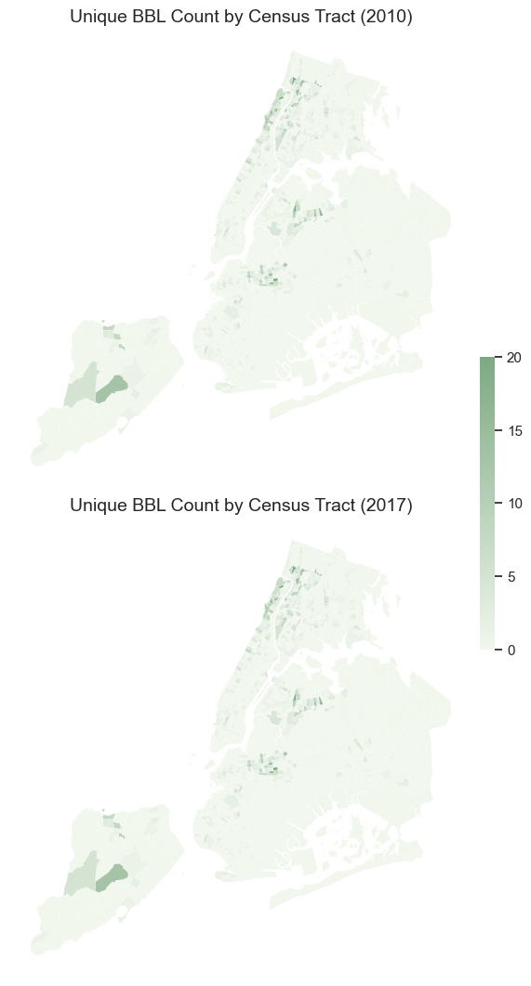
Working Dataset
Buildings remaining in the working dataset were in all five boroughs.
  Manhattan: Inwood, Washington Heights
  The Bronx: Kingsbridge, Concourse, Claremont
  Brooklyn: Clinton Hill, Bedford-Stuyvesant
  Queens: Corona, Jackson Heights, Elmhurst
  Staten Island: Fresh Kills, Richmond

Slide 21
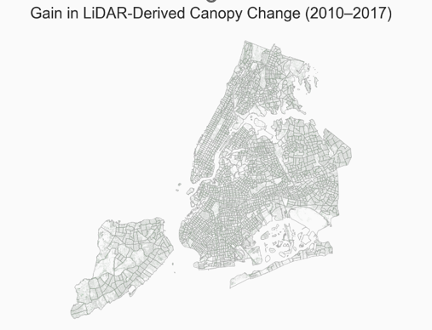
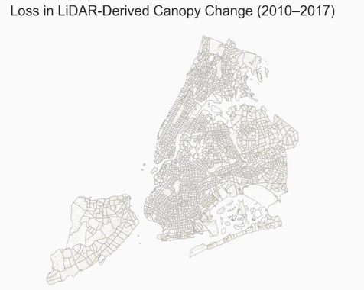
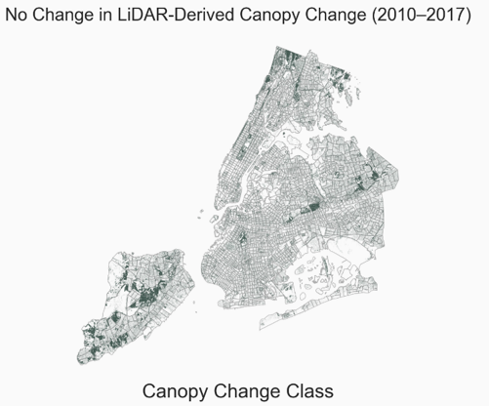

Working Dataset: Canopy Shifts
Most areas show no change in tree canopy coverage between 2010 and 2017.
Canopy gain and loss occur less frequently, limiting variation for analysis

Slide 22
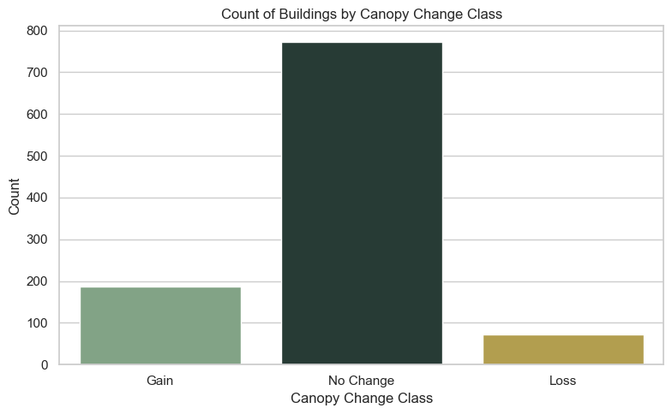
Working Dataset: Building Count by Canopy Change
The majority of buildings fall into the “No Change” canopy category.
Buildings experiencing canopy gain or loss are far fewer in number.
The Loss category contains the smallest number of buildings.

Slide 23
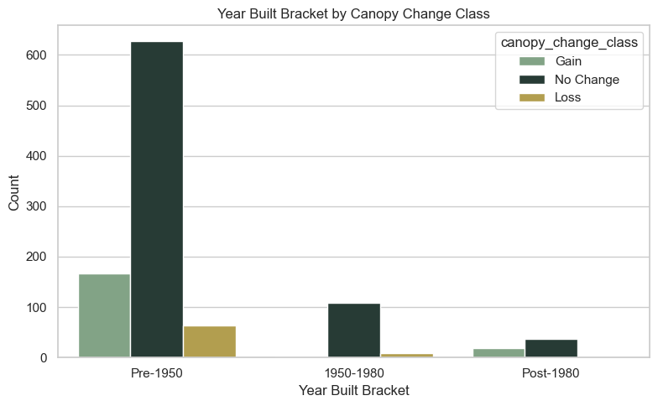
Working Dataset: Building Counts by Year Built
Most buildings in the dataset were constructed before 1950.
Fewer buildings fall into the 1950–1980 and post-1980 categories.
Canopy change categories are most prevalent among older buildings.
Building age is an important characteristic to control for in analysis

Slide 24
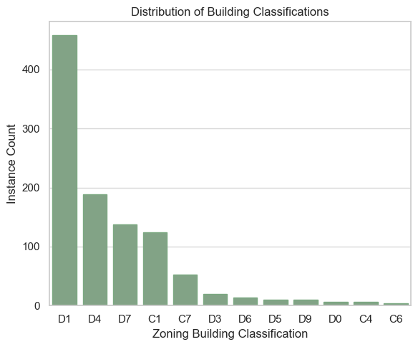
Working Dataset: Building Classification Counts
The dataset is dominated by elevator apartment buildings.
The most common classifications are D1, D4, and D7.
Many buildings include elevators and, in some cases, ground-floor commercial space.
This reflects the multifamily residential focus of Local Law 84 reporting.

Slide 25
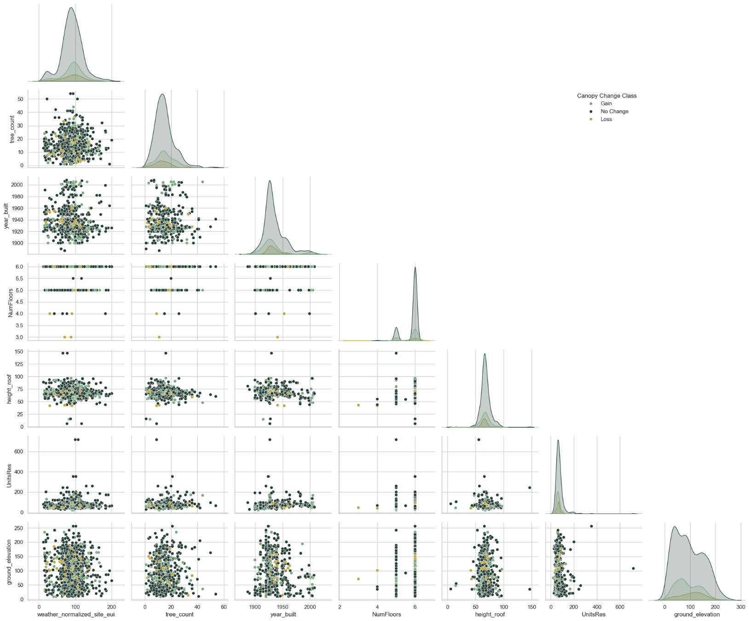
Working Dataset: Pair Plot Numeric Features
No strong visual relationship appears between weather-normalized EUI and tree count.
Energy use varies widely across buildings regardless of canopy change class.
Stronger structure is visible among building characteristics (e.g., height, floors, year built)
Visual inspection suggests limited linear relationship between tree presence and EUI

Slide 26
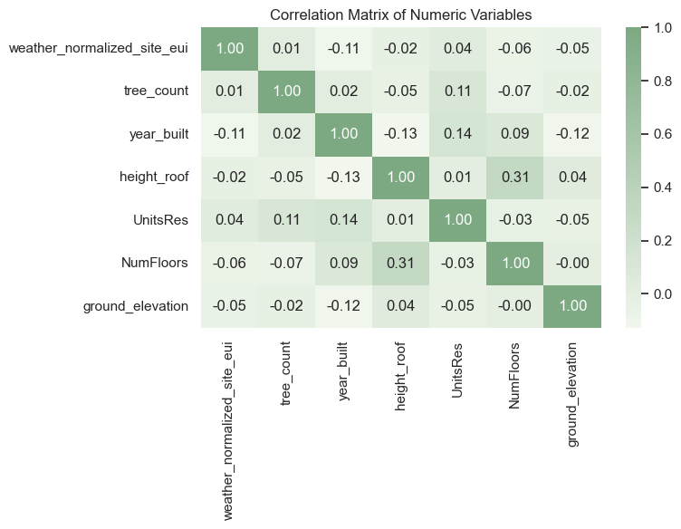
Working Dataset: Correlation Matrix
Weather normalized EUI shows weak correlations with all numeric features.
Tree count has near-zero correlation with EUI.
Stronger correlations appear among building attributes, such as:
  Number of floors and roof height
  Building age and size-related features
These weak correlations indicate limited explanatory power for simple linear models

Slide 27
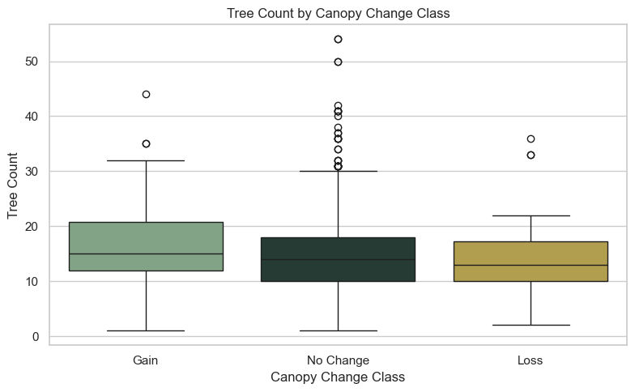
Working Dataset: Box Plots (Tree Counts)
Buildings in the canopy gain category have a slightly higher median tree count.
The loss category shows the lowest median tree count.
The no change category exhibits the greatest variability and highest outliers.

Slide 28
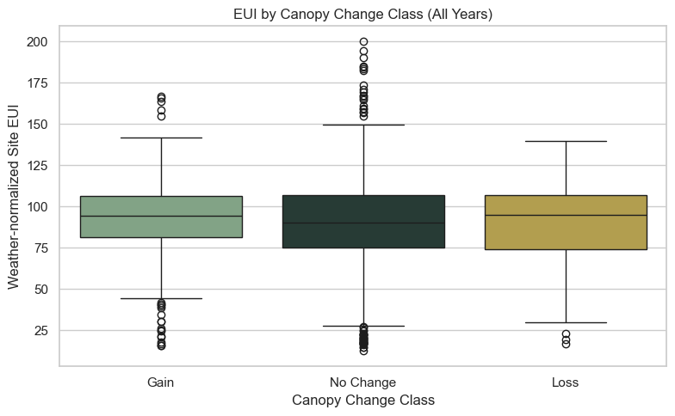
Working Dataset: Box Plots (EUI)
Median EUI values are similar across all canopy change categories.
Distributions overlap between groups.
No clear relationship appears between canopy class and energy use.
Visual evidence suggests canopy change alone does not explain EUI differences.

Slide 29
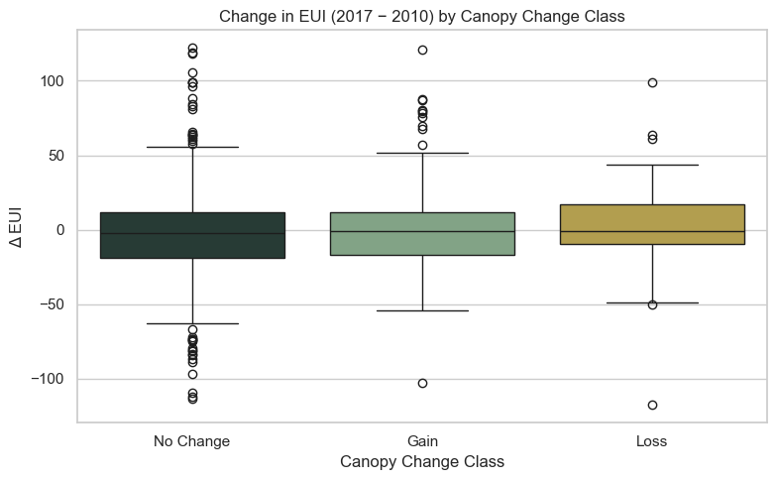
Working Dataset: Box Plots (Delta EUI)
Variation in EUI change is large within each group.
No canopy category shows a distinct shift in energy use over time.
Temporal differencing does not reveal a clear canopy-related pattern.

Slide 30
Modeling & Analysis

Slide 31
Modeling & Analysis
Two modeling approaches:
    Difference-in-Differences (DID)
    Predictive regression (OLS, Ridge, Lasso)

Slide 32
Modeling & Analysis: Difference-in-Differences (DID)
Difference-in-differences (DID) is a quasi-experimental method used to estimate the effect of an exposure when randomized experiments are not feasible.
The approach compares changes over time between:
    Buildings exposed to canopy gain or loss.
    Buildings with no change in canopy coverage.
Focused on changes over time within the same buildings, accounting for consistent building characteristics and shared time trends.
This method was selected based on prior literature examining tree impacts on residential energy use and professor input. Ravazdezh & Rivers (2025)
The model assumes that absent canopy change, energy use trends would have been similar across building groups.

Slide 33
Modeling & Analysis: Difference-in-Differences (DID)
Model Number | Formula | R² Value / Adj. R² Value | AIC / BIC | F-Statistic / Prob. (F-Statistic) | Statistically Sig. Coefficients (p-value <0.05) & Notes
1 | weather_normalized_site_eui ~ post_2017 * canopy_change_class + NumFloors + UnitsRes+ ground_elevation+ height_roof+ C(year_built_bracket) + C(commercial_floor_flag) | 0.037 / 0.026 | 9831 / 9895 | 2.439 / 0.00431 | C(year_built_bracket)[T.1950-1980]
2 | log_eui ~ post_2017 * canopy_change_class + NumFloors + UnitsRes+ ground_elevation+ height_roof+ C(year_built_bracket) + C(commercial_floor_flag) | 0.035 / 0.024 | 1065 / 1130 | 2.090 / 0.0162 | C(year_built_bracket)[T.1950-1980]
3 | sqrt_eui ~ post_2017 * canopy_change_class + NumFloors + UnitsRes+ ground_elevation+ height_roof+ C(year_built_bracket) + C(commercial_floor_flag) | 0.037 / 0.026 | 3944 / 4008 | 2.335 / 0.00645 | C(year_built_bracket)[T.1950-1980]
4 | weather_normalized_site_eui ~ post_2017 * canopy_change_class + NumFloors + C(year_built_bracket) + C(commercial_floor_flag) | 0.032 / 0.024 | 9830 / 9880 | 2.658 / 0.00509 | C(year_built_bracket)[T.1950-1980]
5 | log_eui ~ post_2017 * canopy_change_class + NumFloors + C(year_built_bracket) + C(commercial_floor_flag) | 0.030 / 0.022 | 1065 / 1114 | 2.122 / 0.262 | C(year_built_bracket)[T.1950-1980]
6 | sqrt_eui ~ post_2017 * canopy_change_class + NumFloors + C(year_built_bracket) + C(commercial_floor_flag) | 0.032 / 0.023 | 3943 / 3993 | 2.449 / 0.00978 | C(year_built_bracket)[T.1950-1980]
7 | weather_normalized_site_eui ~ post_2017 * canopy_change_class | 0.001 / -0.003 | 9854 / 9884 | 0.4113 / 0.841 | N/A
8 | log_eui ~ post_2017 * canopy_change_class | 0.002 / -0.003 | 1087 / 1116 | 0.4514 / 0.812 | N/A
9 | sqrt_eui ~ post_2017 * canopy_change_class | 0.001 / -0.003 | 3967 / 3997 | 0.3788 / 0.863 | N/A

Slide 34
Modeling & Analysis: Difference-in-Differences (DID)
Across all specifications, canopy change coefficients are not statistically significant.
Model fit is consistently weak, suggesting limited explanatory power.
These results indicate that, within this dataset and time window, canopy change does not produce a detectable shift in weather normalized EUI.
The only consistently significant covariate is the 1950–1980 year-built bracket, suggesting building age plays a larger role than tree-related features.
Overall, the DID results suggest that any tree-related energy effect is small relative to dominant building characteristics.

Slide 35
Modeling & Analysis: Predictive Regressions
Ordinary Least Squares (OLS), Ridge, and Lasso regressions were used as complementary predictive models.
Unlike DID, these models focus on prediction and feature importance, rather than causal comparison.
Ridge and Lasso regression models were selected to address multicollinearity among building and tree-related features and to reduce overfitting. These models use penalization terms with the OLS framework.
A delta EUI variable and a delta tree count variable was created representing the change in energy use between 2017 and 2010.
The dataset was restructured to support predictive modeling. This meant that the data had one row per building along with the new delta values.
Preprocessing like encoding categorical variables and standardizing numeric variables were caried out.

Slide 36
Modeling & Analysis: Predictive Regressions
Model Number | Method | R² Value | Found Alpha | RMSE/ MSE / MAE
1 | OLS Model | -0.2282 | N/A | 1230.177 / 35.074 / 24.516
2 | Ridge Model (cv = 5) | -0.0305 | 572.236 | 1032.155 / 32.127 / 22.089
3 | Lasso Model (cv = 5) | -0.0341 | 1.072 | 1035.806 / 32.184 / 22.087

Slide 37
Modeling & Analysis: Predictive Regressions
All predictive models perform poorly on held-out test data, with negative R² values.
This indicates that the available features do not meaningfully predict changes in EUI
Tree focused variables do not show up as important predictors in these models.
The weak performance suggests that:
    Key drivers of energy use variation are unobserved, or
    Relationships between features and EUI are non-linear
These findings reinforce the DID results, suggesting limited detectable impact of trees on energy use for this building subset.

Slide 38
Conclusions & Future Work

Slide 39
Findings
Across all modeling approaches, no statistically significant relationship was found between changes in tree canopy coverage and changes in weather normalized energy use intensity (EUI) for the multifamily residential buildings examined.
Difference-in-differences models produced low explanatory power, with canopy change coefficients consistently not statistically significant.
Predictive regression models (OLS, Ridge, and Lasso) also performed poorly, yielding negative R² values on test data.
The 1950–1980 year-built bracket was the only feature that consistently showed a statistically significant relationship with EUI variation.
Overall, these results suggest that building characteristics play a larger role than nearby tree presence in explaining energy use for this subset of buildings

Slide 40
Challenges
Local Law 84 reporting primarily covers larger residential buildings, where the energy impacts of nearby trees are likely diminished compared to smaller structures.
Many studies in the existing literature focus on single-family or low-rise homes, limiting direct comparability with this analysis.
Tree-related data lacked important attributes such as tree age, size, and canopy density, which influence shading and wind-blocking effects.
The forestry tree inventory used may reflect data collected after 2010, introducing uncertainty in baseline tree presence.
The analysis was constrained to two time points (2010 and 2017), limiting the ability to observe longer-term trends.

Slide 41
Future Work
Integrate data from the 2025 NYC Tree Census when available and leverage additional years of Local Law 84 energy benchmarking data (including 2015 and 2025) to incorporate more detailed tree attributes and introduce greater temporal depth into the analysis.
Incorporate NYC Department of Buildings permit and renovation data to control for building upgrades over time.
Expand the scope to include smaller residential buildings if comparable energy use data becomes available (e.g., Local Law 84 Amendments, Third Party Building data, etc.)

Slide 42
Thank you!
John Ferrara
john.ferrara96@spsmail.cuny.edu

